Slide 1
Computer Science
Binary Relation
Samuel Lukas

Slide 2
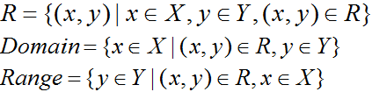


Introduction
Let A and B be sets, A binary relation from A to B is a subset of A x B. if $aεA \& bεB \& a R b to denote (a,b)εR$.

Slide 3
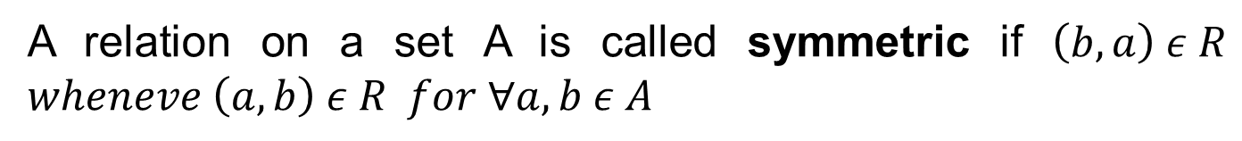
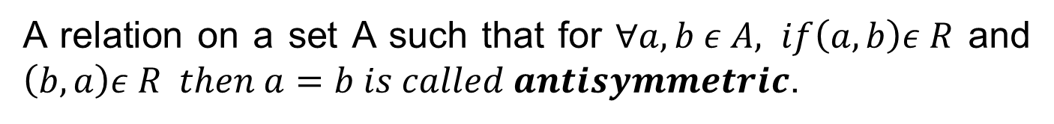
Properties of Relations
A relation on a set A is called reflexive if $\left(a,a\right)ε R for ∀a ε A$
A relation on a set A is called symmetric if $\left(b,a\right) ε R$ $wheneve \left(a,b\right) ε R for ∀a,b ε A$
A relation on a set A such that for $∀a,b ε A, if\left(a,b\right)ε R$ and $\left(b,a\right)ε R then a=b is called antisymmetric$.
$$R:A→A, A=\left\{1,2,3,4\right\} R=\{(a,b)|a≤b\}$$
R is reflexive, not symmetric but anti-symmetric
$$R:A→A, A=\left\{1,2,3,4\right\} R=\{\left(1,1\right),\left(2,3\right),\left(3,2\right),(4,4)\}$$
R is not-reflexive, symmetric, but not anti-symmetric

Slide 4
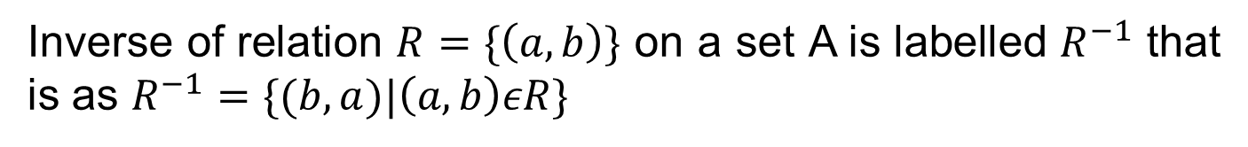
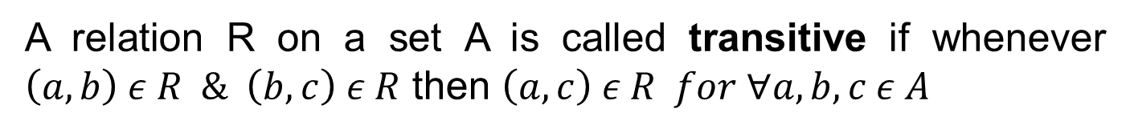
Properties of Relations (cont)
,
.
A relation R on a set A is called transitive if whenever $\left(a,b\right) ε R \& \left(b,c\right) ε R$ then $\left(a,c\right) ε R for ∀a,b,c ε A$
A relation R on a set A is called Partially order set (Poset) if R has properties reflexive, anti-symmetric and transitive.
A relation R on a set A is called Equivalence relation if R is reflexive, symmetric and transitive.
Inverse of relation $R=\{\left(a,b\right)\}$ on a set A is labelled $R^{−1}$ that is as $R^{−1}=\{(b,a)|\left(a,b\right)εR\}$

Slide 5
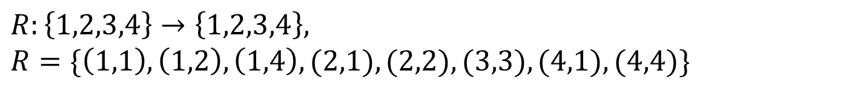

Example 01
$R:\left\{a,b,c\right\}→\{a,b,c\}, R=\{(a,a),(b,b),(c,c)\}$
R is Reflexive, Symmetric, Anti-symmetric & Transitive.
$$R:\left\{1,2,3,4\right\}→\left\{1,2,3,4\right\},$$
$R=\{\left(1,1\right),\left(1,2\right),\left(1,4\right),(2,1),(2,2),(3,3),(4,1),(4,4)\}$
R is reflexive, symmetric, not anti-symmetric & not transitive.
$R=\{\left(2,1\right),\left(3,1\right),\left(3,2\right),(4,1),(4,2),(4,3)\}$
R is not reflexive, not symmetric, anti-symmetric & transitive.
How many reflexive relations are there on a set with n elements ?
$$2^{n(n−1)}$$

Slide 6
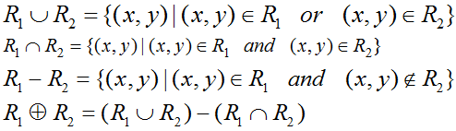

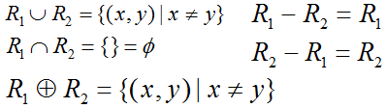
Combining Relations

Slide 7
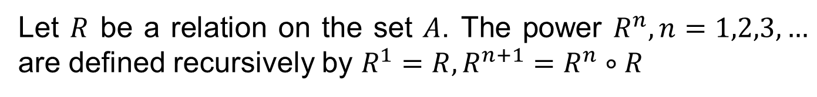
Composition Relations
Let $R$ be a relation on the set $A$. The power $R^{n}, n=1,2,3,…$ are defined recursively by $R^{1}=R, R^{n+1}=R^{n}∘R$
$R= \{(1,1),(2,1),(3,2),(4,3)\}$. Find $Rn, n = 2,3,4,…$
The relation $R$ on a set $A$ is transitive Iff $R^{n}⊆R for n=1,2,3,…$
$R= \{(1,1),(2,1),(3,2),(4,3)\}$ is not transitive
$R=\left\{\left(2,1\right),\left(3,1\right),\left(3,2\right),\left(4,1\right),\left(4,2\right),\left(4,3\right)\right\}$is transitive

Slide 8

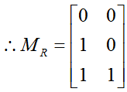

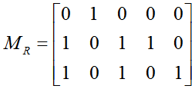
Representing Relations using Matrices
Can we see the properties of relation easier by matrices ?

Slide 9
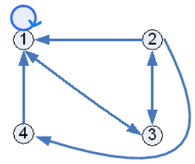
Representing Relations using Digraph
Can we see the properties of relation easier by digraph ?

Slide 10
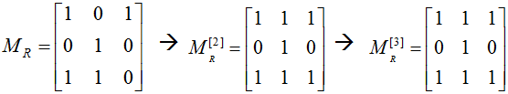


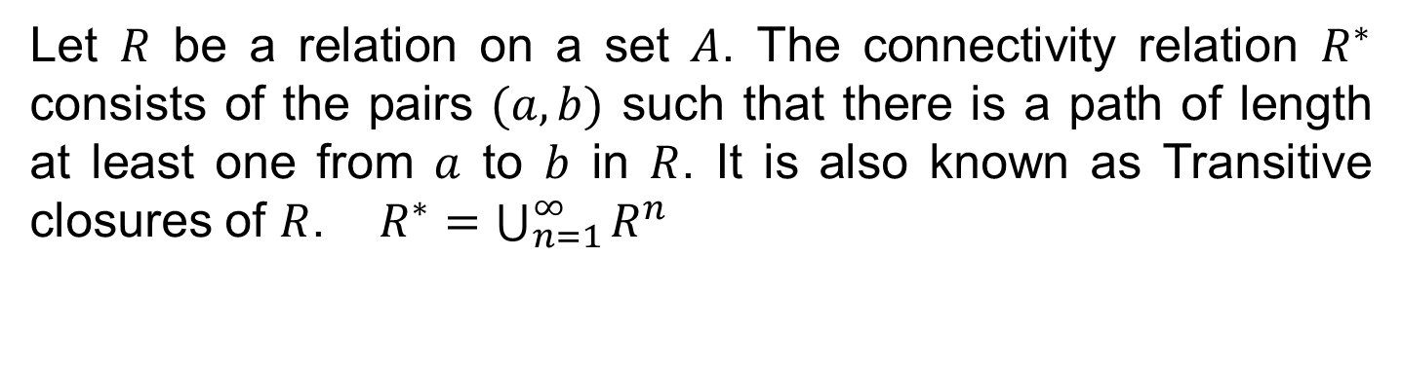
Transitive Closures
Let $R$ be a relation on a set $A$. The connectivity relation $R^{∗}$ consists of the pairs $(a,b)$ such that there is a path of length at least one from $a$ to $b$ in $R$. It is also known as Transitive closures of $R$. $R^{∗}=\bigcup_{n=1}^{∞}{R^{n}}$
Find the transitive closure of
$$R = \{(1,1),(1,3),(2,2),(3,1),(3,2)\}$$
$$R∗ = \{(1,1),(1,2),(1,3),(2,2),(3,1),(3,2),(3,3)\}$$

Slide 11
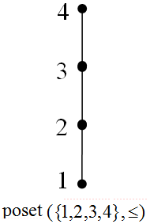
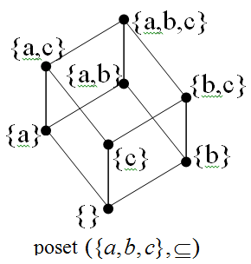
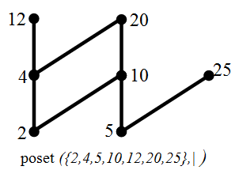
Poset, Hasse Diagram, Lattice
For every pair of Poset elements has both a least upper bound and a greatest lower bound is called Lattice
poset ({1,2,4,8,16},|) is lattice
Maximal elements are 12 or 20 or 25
Minimal elements are 2 or 5
No greatest element neither the least elements
Upper bound of {2,5} are 10 ore 20
No lower bound of {2,5}

